Slide 1
FACIAL EMOTION DETECTION

Slide 2

TEAM-
V HARSHA VARDHAN AP22110010677
G Pavan Kumar AP22110010896

Slide 3

C
Technology Stack:
Python as the primary programming language.
PyTorch for building and training the deep learning model.
OpenCV and NumPy for image processing and data handling.
CNN + Spatial Transformer Network (STN) as the core model architecture.
FER2013 dataset with pre-processing, normalization, and evaluation tools.
B
Project Objective:
To develop a deep learning model that accurately recognizes human emotions from facial images.
To extract meaningful features using a CNN and improve focus using a Spatial Transformer Network.
To handle real-world challenges such as occlusion, lighting variations, and pose differences.
To train and evaluate the model on the FER2013 dataset for reliable performance.
To achieve better accuracy compared to traditional and existing baseline methods.
A
Abstract:
Facial emotion recognition is a challenging task due to variations in lighting, pose, occlusion, and the way individuals express emotions. Traditional hand-crafted feature methods struggle in real-world conditions, leading to the adoption of deep learning techniques. In this project, we propose a CNN-based model enhanced with a Spatial Transformer Network to focus on important facial regions such as the eyes and mouth. The model is trained on the FER2013 dataset, which contains diverse and unconstrained facial images.

Slide 4
A
Abstract:
Facial emotion recognition is a challenging task due to variations in lighting, pose, occlusion, and the way individuals express emotions. Traditional hand-crafted feature methods struggle in real-world conditions, leading to the adoption of deep learning techniques. In this project, we propose a CNN-based model enhanced with a Spatial Transformer Network to focus on important facial regions such as the eyes and mouth. The model is trained on the FER2013 dataset, which contains diverse and unconstrained facial images.
B
Project Objective:
To develop a deep learning model that accurately recognizes human emotions from facial images.
To extract meaningful features using a CNN and improve focus using a Spatial Transformer Network.
To handle real-world challenges such as occlusion, lighting variations, and pose differences.
To train and evaluate the model on the FER2013 dataset for reliable performance.
To achieve better accuracy compared to traditional and existing baseline methods.
C
Technology Stack:
Python as the primary programming language.
PyTorch for building and training the deep learning model.
OpenCV and NumPy for image processing and data handling.
CNN + Spatial Transformer Network (STN) as the core model architecture.
FER2013 dataset with pre-processing, normalization, and evaluation tools.

Slide 5

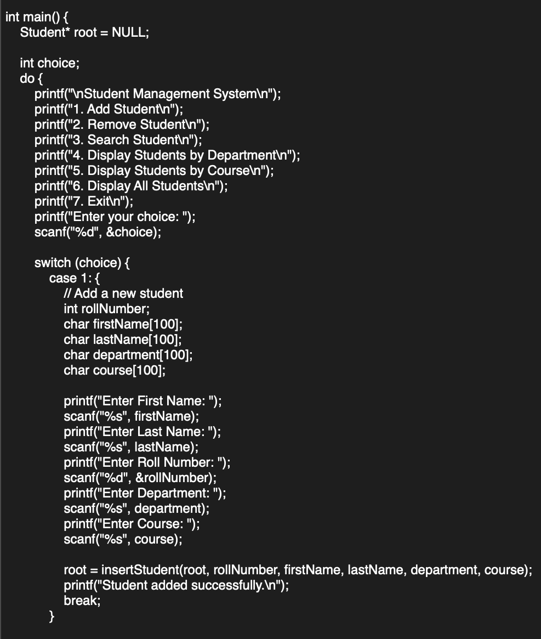
Dataset Description (FER2013)
Contains 35,887 grayscale images, each of size 48×48.
Collected from real-world environments using Google Search API.
Includes 7 emotion classes:
Angry, Happy, Sad, Fear, Disgust, Surprise, Neutral
Challenges in the dataset:
  Poor lighting
  Partial faces
  Occlusions (hands, hair, glasses)
  Large variation in expressions
Pre-processing Steps
To ensure the model learns correctly, several pre-processing techniques are applied:
Grayscale Normalization
  Pixel values scaled for stable training.
Resize Images to 48×48
  Maintains uniformity across dataset.
Data Normalization
  Helps CNN converge faster and avoid exploding gradients.
STN-based Alignment
  Automatically rotates/transforms images to focus on important regions.
These steps make the input clean and consistent.
Spatial Transformer Network (STN)
Faces may be tilted, rotated, or partially visible.
STN helps the model focus on the correct region.
How it Works
Localization Network
  Small CNN predicts transformation parameters θ.
  Learns how the face should be aligned.
Grid Generator
  Uses θ to create a sampling grid.
Sampler
  Applies the grid to the image → produces a better-aligned face.
Result
Only important parts (eyes, mouth, eyebrows) remain in focus → improves accuracy.

Slide 6
Dataset Description (FER2013)
Contains 35,887 grayscale images, each of size 48×48.
Collected from real-world environments using Google Search API.
Includes 7 emotion classes:
Angry, Happy, Sad, Fear, Disgust, Surprise, Neutral
Challenges in the dataset:
  Poor lighting
  Partial faces
  Occlusions (hands, hair, glasses)
  Large variation in expressions
Pre-processing Steps
To ensure the model learns correctly, several pre-processing techniques are applied:
Grayscale Normalization
  Pixel values scaled for stable training.
Resize Images to 48×48
  Maintains uniformity across dataset.
Data Normalization
  Helps CNN converge faster and avoid exploding gradients.
STN-based Alignment
  Automatically rotates/transforms images to focus on important regions.
These steps make the input clean and consistent.
Spatial Transformer Network (STN)
Faces may be tilted, rotated, or partially visible.
STN helps the model focus on the correct region.
How it Works
Localization Network
  Small CNN predicts transformation parameters θ.
  Learns how the face should be aligned.
Grid Generator
  Uses θ to create a sampling grid.
Sampler
  Applies the grid to the image → produces a better-aligned face.
Result
Only important parts (eyes, mouth, eyebrows) remain in focus → improves accuracy.

Slide 7
Dataset Description (FER2013)
Contains 35,887 grayscale images, each of size 48×48.
Collected from real-world environments using Google Search API.
Includes 7 emotion classes:
Angry, Happy, Sad, Fear, Disgust, Surprise, Neutral
Challenges in the dataset:
  Poor lighting
  Partial faces
  Occlusions (hands, hair, glasses)
  Large variation in expressions
Pre-processing Steps
To ensure the model learns correctly, several pre-processing techniques are applied:
Grayscale Normalization
  Pixel values scaled for stable training.
Resize Images to 48×48
  Maintains uniformity across dataset.
Data Normalization
  Helps CNN converge faster and avoid exploding gradients.
STN-based Alignment
  Automatically rotates/transforms images to focus on important regions.
These steps make the input clean and consistent.
Spatial Transformer Network (STN)
Faces may be tilted, rotated, or partially visible.
STN helps the model focus on the correct region.
How it Works
Localization Network
  Small CNN predicts transformation parameters θ.
  Learns how the face should be aligned.
Grid Generator
  Uses θ to create a sampling grid.
Sampler
  Applies the grid to the image → produces a better-aligned face.
Result
Only important parts (eyes, mouth, eyebrows) remain in focus → improves accuracy.

Slide 8
CNN Architecture (Layer-by-Layer)
Convolution Layer 1
  10 filters of size 3×3
  Detects basic features (edges, lines, light/dark patterns)
2. ReLU Activation
  Introduces non-linearity
  Helps model learn complex patterns
3. Max Pooling
  Reduces image size
  Keeps the strongest features
4. Convolution Layer 2 (Conv2)
  10 filters of size 3×3
  Learns deeper patterns (eye shape, mouth curves)
5. ReLU + Max Pooling
  Same behaviour as above
  Extracts robust features
6. Flattening
  Converts extracted features into a vector of size 810
7. Fully Connected Layer (FC1)
  Reduces features from 810 → 50
  Learns emotion-specific combinations of features
8. Fully Connected Layer (FC2)
  Final layer with 7 outputs
  Each output corresponds to an emotion class
9. SoftMax
  Converts outputs to probabilities
  Highest probability = predicted emotion
How the Model Detects Emotions
Step 1 – Input Face Image
The image is passed into the model.
Step 2 – Feature Extraction (Conv Layers)
Conv layers detect patterns such as:
  Raised eyebrows (surprise)
  Curved lips (happy)
  Downward mouth corners (sad)
  Tightened jaw (angry)
  Wide open eyes (fear)
Step 3 – Region Focus via STN
  Important areas: eyes, mouth, nose
  Non-important areas: hair, background
  STN ignores unnecessary regions.

Slide 9
CNN Architecture (Layer-by-Layer)
Convolution Layer 1
  10 filters of size 3×3
  Detects basic features (edges, lines, light/dark patterns)
2. ReLU Activation
  Introduces non-linearity
  Helps model learn complex patterns
3. Max Pooling
  Reduces image size
  Keeps the strongest features
4. Convolution Layer 2 (Conv2)
  10 filters of size 3×3
  Learns deeper patterns (eye shape, mouth curves)
5. ReLU + Max Pooling
  Same behaviour as above
  Extracts robust features
6. Flattening
  Converts extracted features into a vector of size 810
7. Fully Connected Layer (FC1)
  Reduces features from 810 → 50
  Learns emotion-specific combinations of features
8. Fully Connected Layer (FC2)
  Final layer with 7 outputs
  Each output corresponds to an emotion class
9. SoftMax
  Converts outputs to probabilities
  Highest probability = predicted emotion
How the Model Detects Emotions
Step 1 – Input Face Image
The image is passed into the model.
Step 2 – Feature Extraction (Conv Layers)
Conv layers detect patterns such as:
  Raised eyebrows (surprise)
  Curved lips (happy)
  Downward mouth corners (sad)
  Tightened jaw (angry)
  Wide open eyes (fear)
Step 3 – Region Focus via STN
  Important areas: eyes, mouth, nose
  Non-important areas: hair, background
  STN ignores unnecessary regions.

Slide 10
CNN Architecture (Layer-by-Layer)
Convolution Layer 1
  10 filters of size 3×3
  Detects basic features (edges, lines, light/dark patterns)
2. ReLU Activation
  Introduces non-linearity
  Helps model learn complex patterns
3. Max Pooling
  Reduces image size
  Keeps the strongest features
4. Convolution Layer 2 (Conv2)
  10 filters of size 3×3
  Learns deeper patterns (eye shape, mouth curves)
5. ReLU + Max Pooling
  Same behaviour as above
  Extracts robust features
6. Flattening
  Converts extracted features into a vector of size 810
7. Fully Connected Layer (FC1)
  Reduces features from 810 → 50
  Learns emotion-specific combinations of features
8. Fully Connected Layer (FC2)
  Final layer with 7 outputs
  Each output corresponds to an emotion class
9. SoftMax
  Converts outputs to probabilities
  Highest probability = predicted emotion
How the Model Detects Emotions
Step 1 – Input Face Image
The image is passed into the model.
Step 2 – Feature Extraction (Conv Layers)
Conv layers detect patterns such as:
  Raised eyebrows (surprise)
  Curved lips (happy)
  Downward mouth corners (sad)
  Tightened jaw (angry)
  Wide open eyes (fear)
Step 3 – Region Focus via STN
  Important areas: eyes, mouth, nose
  Non-important areas: hair, background
  STN ignores unnecessary regions.

Slide 11
Step 4 – Emotion-Specific Feature Mapping
FC layers map features to emotions:
  Happy → upward mouth curve, cheek lift
  Sad → downward mouth curve, droopy eyes
  Angry → tight lips, furrowed eyebrows
  Surprise → wide open eyes, raised eyebrows
  Fear → widened eyes + stretched mouth
  Disgust → nose wrinkle + raised upper lip
  Neutral → no significant muscle tension
Step 5 – SoftMax Prediction
The model outputs 7 probabilities:
Example:
Happy: 0.82, Sad: 0.05, Angry: 0.03 …
Highest value → final emotion
Results & Comparison
FER2013 Accuracy: 70.02%
Method | Accuracy
Bag of Words | 67.4%
VGG + SVM | 66.31%
Google Net | 65.2%
Mollahosseini Model | 66.4%
Your Proposed Model | 70.02%

Slide 12
Step 4 – Emotion-Specific Feature Mapping
FC layers map features to emotions:
  Happy → upward mouth curve, cheek lift
  Sad → downward mouth curve, droopy eyes
  Angry → tight lips, furrowed eyebrows
  Surprise → wide open eyes, raised eyebrows
  Fear → widened eyes + stretched mouth
  Disgust → nose wrinkle + raised upper lip
  Neutral → no significant muscle tension
Step 5 – SoftMax Prediction
The model outputs 7 probabilities:
Example:
Happy: 0.82, Sad: 0.05, Angry: 0.03 …
Highest value → final emotion
Results & Comparison
FER2013 Accuracy: 70.02%
Method | Accuracy
Bag of Words | 67.4%
VGG + SVM | 66.31%
Google Net | 65.2%
Mollahosseini Model | 66.4%
Your Proposed Model | 70.02%

Slide 13
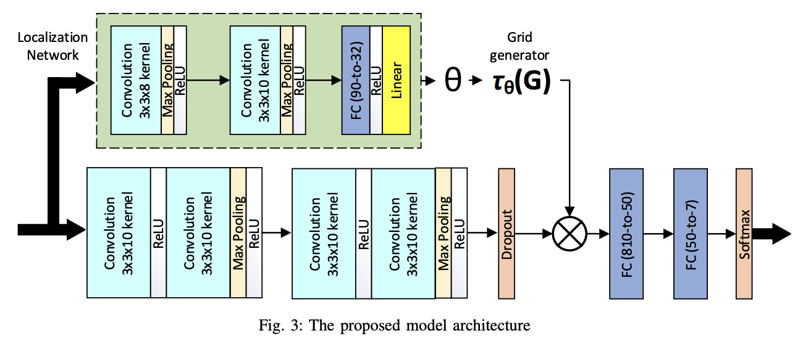

Slide 14



